Slide 1
BIENVENIDOS TO SPANISH 104

Slide 2
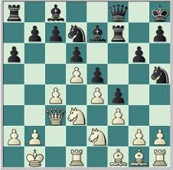
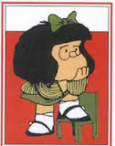
Importante:
Who Can Take This Course?
Students who have successfully completed Spanish 103 at UIC.
Students who took the UIC placement exam and were placed into this class.

Slide 3
Importante:
The following materials are required for this course
textbook and codes
(If you do not have your book for in-class participation or access to the online homework you will lose participation and homework points).

Slide 4
Course evaluation

Slide 5
Importante:
Participation Policy
2 POINTS | All of the following: arrives on time, attends entire class period, has textbook (and printed any extra material), is prepared for class, participates in activities, speaks Spanish in class, works well with others
1 POINT | Any one of the following: arrives late, leaves early, does not have textbook (or did not print necessary extra material), does not participate in activities as instructed, speaks English in class, doesn’t work with others
0 POINTS | More than one of anything listed in the 1 point description and/or any one of the following: is absent or disruptive (does homework for other classes, checks cell phone, sleeps, etc.)

Slide 6
Importante:
You may miss class 1 time for any reason without losing participation points.
Use this allowed absences wisely as there are NO excused absences.
You should read Syllabus and ask if you have questions
No “make-ups”.

Slide 7
PRIMERA PARTE Warming up
¿Cómo está tu “español”?
Vamos a ver

Slide 8
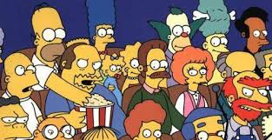
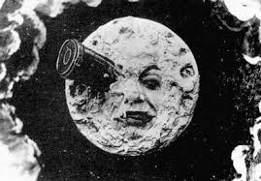
Escriban el nombre (name), carrera (major), una película o programa de televisión (movie o tv show) o libro favorito (favorite book) que les guste y por qué les gustó:
Mi nombre es Óscar Campo________________
Me gusta The Handsmaid’s Tale, el fútbol (soccer) y el libro The Brief Wondrous Life of Oscar Wao de Ben Lerner, porque son entretenidos y hablan de temas que me interesan.

